Slide 1
AIRBNB PRICE OPTIMIZATION
Submitted by: Nihala Mol Vadakkethodi

Slide 2
Project Scope
This project involves data cleaning and exploratory data analysis to gain insights about Airbnb in New York City and their pricing based on their various factors, also to understand how the phenomena of each variable behave individually and transversely, in addition to generate hypotheses useful for future decision-making . The whole analysis will follow a simple and direct structure, well detailed in all topics, aiming at the same time, to create an intuitive and simple guide of which steps must be followed to carry out a good analysis, to in order to understand the data involved in any study.
OBJECTIVE​
Price analysis​
Distribution of Variables​
Univariate Analysis​
Bivariate Analysis​
Multivariate Analysis

Slide 3
About Dataset
Context:
Since 2008, guests and hosts have used Airbnb to expand on traveling possibilities and present more unique, personalized way of experiencing the world. This dataset describes the listing activity and metrics in NYC, NY for 2019.
Content:
This data file includes all needed information to find out more about hosts, geographical availability, necessary metrics to make predictions and draw conclusions.
Various field of dataset are :
id: listing ID room_type: listing space type
name: name of the listing price: price in dollars
host_id: host ID minimum_nights: amount of nights minimum
host_name: name of the host number_of_reviews: number of reviews
neighbourhood_group: location last_review: latest review
neighbourhood: area reviews_per_month: number of reviews per month
latitude: latitude coordinates calculated_host_listings_count: amount of listing per host
longitude: longitude coordinates availability_365: number of days when listing is available for booking

Slide 4
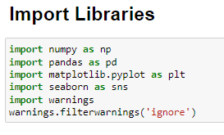

EDA Using Python
1.1 Import Libraries
import numpy as np – For numerical data analysis
import pandas as pd – For data manipulatio
import matplotlib.pyplot as plt – For data visualization
import seaborn as sns – For data visualization
import warnings – To ignore warnings
warnings.filterwarnings('ignore')
1.2 Data Loading
Load Airbnb Newyork csv data file

Slide 5
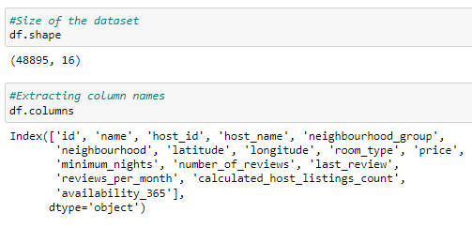
EDA Using Python
Data Understanding
Number of rows = 48895
Number of columns = 16
Columns of the data = 'id', 'name', 'host_id', 'host_name', 'neighbourhood_group', 'neighbourhood', 'latitude', 'longitude', 'room_type', 'price', 'minimum_nights', 'number_of_reviews', 'last_review', 'reviews_per_month', 'calculated_host_listings_count', 'availability_365'

Slide 6
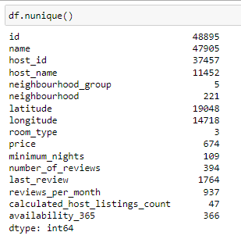
EDA Using Python
Number of unique values in each column
id 48895 name 47905 host_id 37457 host_name 11452 neighbourhood_group 5 neighbourhood 221 latitude 19048 longitude 14718 room_type 3 price 674 minimum_nights 109 number_of_reviews 394 last_review 1764 reviews_per_month 937 calculated_host_listings_count 47 availability_365 365

Slide 7


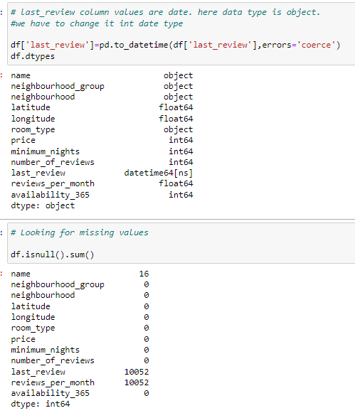
EDA Using Python
Data Cleaning
There is no duplicate values in the dataset
Drop irrelevant columns
'id','host_id','host_name','calculated_host_listings_count' are irrelevant columns.
Therfore dropping it
Number of rows after dropping= 48895
Number of columns after dropping = 12
Correct the data types of the column
'Last_review' column values are date. Here data type showing is object.
we have to change object into date data type
Missing values present are :-
name 16
last_review 10052 reviews_per_mont 10052

Slide 8
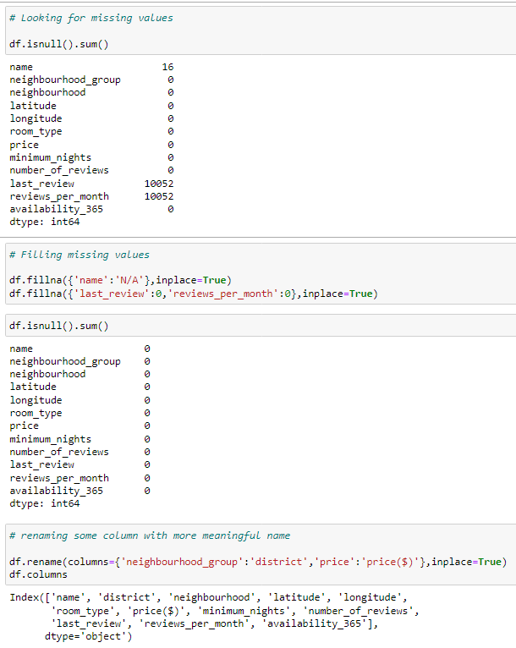
EDA Using Python
Filling the missing values
Filled the missing values of 'name' with 'NA'
Filled the missing values of 'last_review' and 'reviews_per_month' with 0
Renaming column name with more relevant names
Renaming 'neighbourhood' to 'district and 'price' to 'price($)'

Slide 9
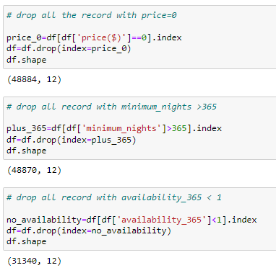
EDA Using Python
Dealing with outliers
Records with 'price' = 0 are irrelevant. So dropping them.
Number of rows after dropping= 48884
Number of columns after dropping = 12
Records with 'minimum nights' >365 are irrelevant . So dropping them.
Number of rows after dropping= 48870
Number of columns after dropping = 12
Records with availability_365 <1 are irrelevant. So dropping them.
Number of rows after dropping= 31340
Number of columns after dropping = 12

Slide 10
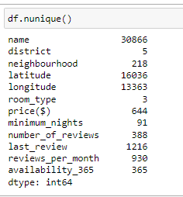
EDA Using Python
Number of unique values in each column after data cleaning
name 30866 district 5 neighbourhood 218 latitude 16036 longitude 13363 room_type 3 price($) 644 minimum_nights 91 number_of_reviews 388 last_review 1216 reviews_per_month 930 availability_365 365

Slide 11

Data Visualization
Using Python and Power BI

Slide 12
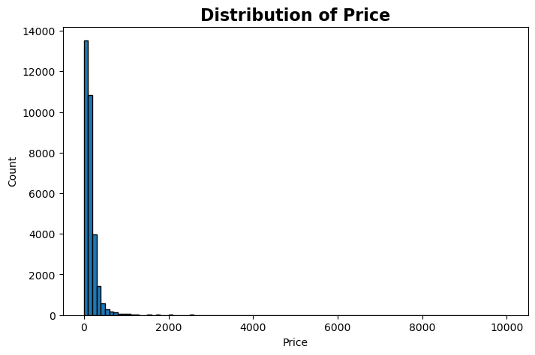
Univariate Analysis
Price distribution
INSIGHTS
Using a histogram, we can see how the prices are distributed, we notice that the largest concentration of values is below 200 dollars.
It's observed that a total of 47 994 (98.15%) of reserves are between 0 and 58.823 dollars and 691(1.41%) are between 58,823 and 117,647 dollars.

Slide 13
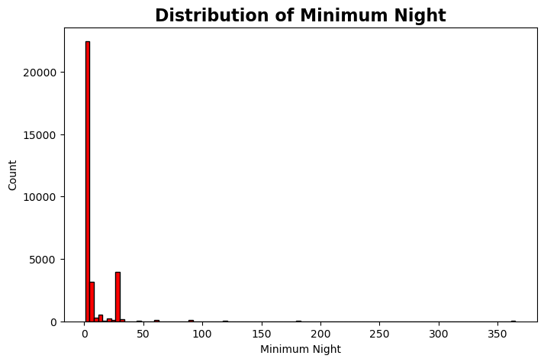
Distribution of Minimum Night
INSIGHTS
We can see that the minimum number of nights for all reservations made on Airbnb are concentrated below 10 with a small peak at 30
We can see that 48,577(99.34%) of the reserves made on Airbnb are for a minimum number of nights between 1 to 73.47.

Slide 14
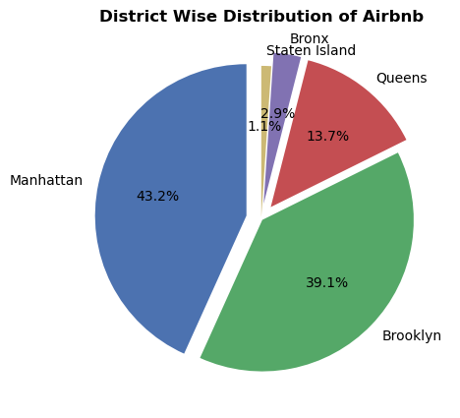
District wise Distribution of Airbnb
INSIGHTS
Manhattan has the highest share of Airbnb with 13553 (39.1%)in New York followed by Brooklyn with 12247 (43.2%)
Staten Island has the least share of Airbnb with 331(1.1%) followed by Bronx with 913 (2.9%)

Slide 15
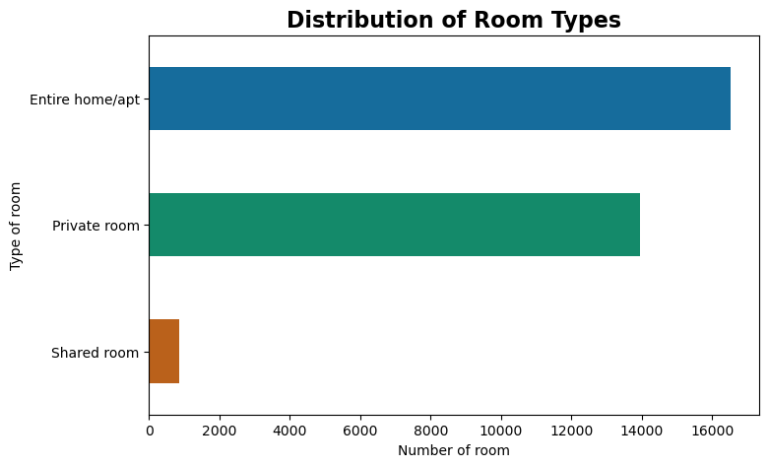
Distribution of Room Types
INSIGHTS
As per the graph, with 16523 value Entire home/apt type is the highest type of Airbnb in NYC. Followed by Private room with 13956 and shared room with 861

Slide 16
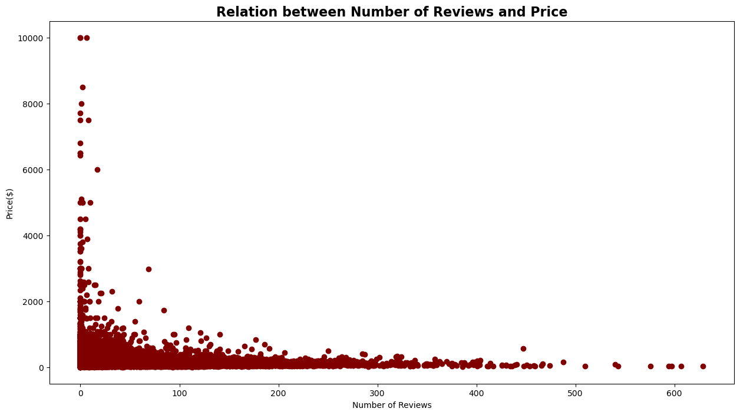
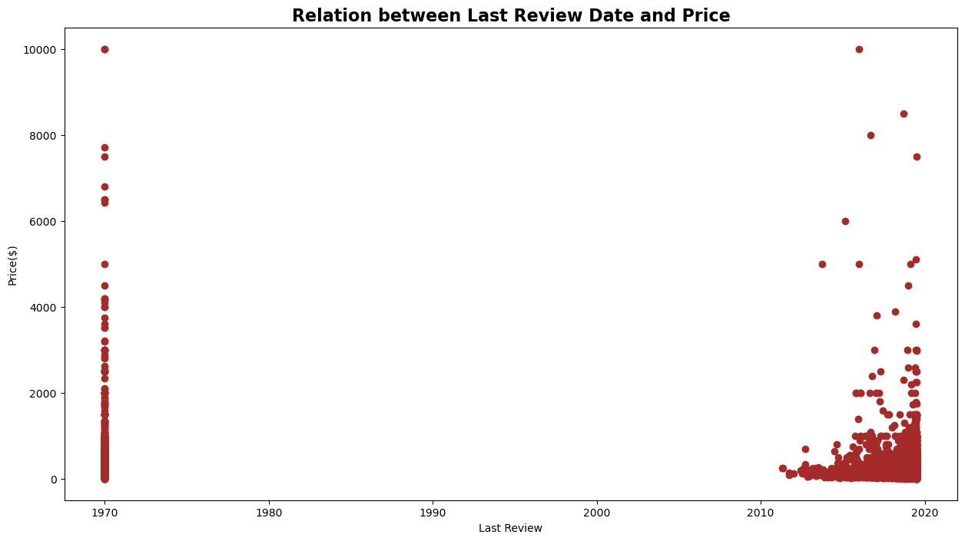
Bivariate Analysis
Number of Reviews and Price Last Review and Price
INSIGHTS
There might be competitive market, so the pricing is relatively low to attract more customers and more reviews subsequently. But from this scatter plot it is clear that higher the price lower the number of reviews.

Slide 17
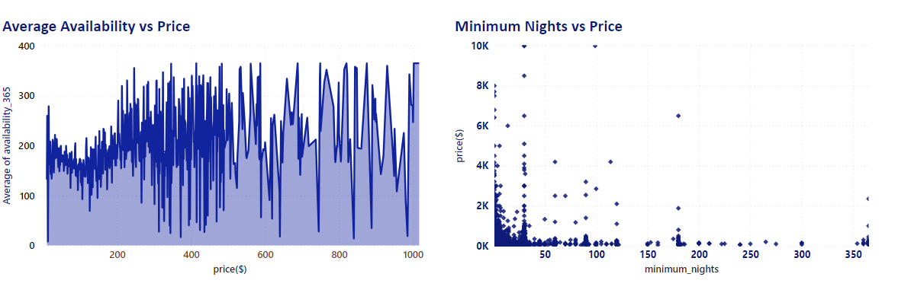
Average Availability and Price
Minimum Nights and Price
INSIGHTS
There is very less relation of availability and minimum nights with price.

Slide 18
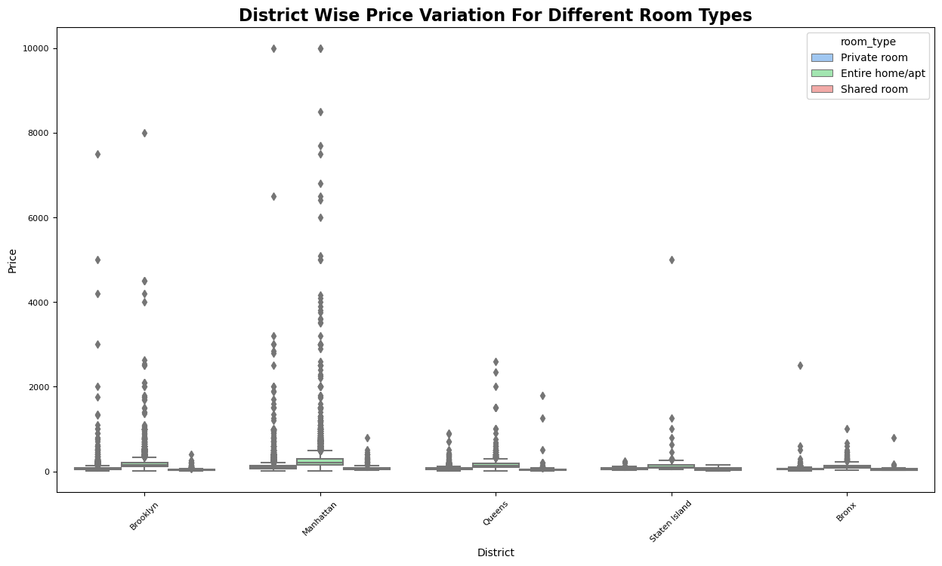
District Wise Price Variation for Different Room Types
INSIGHTS
We can see that there are prices which are extreme outliers, but that can be real prices. As we have no additional information about the price point let's consider it to be real price points

Slide 19
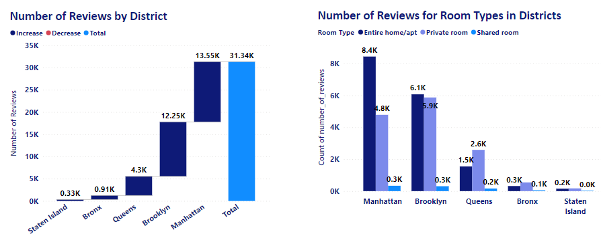
Number of Reviews by District
Number of Reviews for Room Types in District
INSIGHTS
Manhattan is the most reviewed neighbourhood group followed by Brooklyn, in which entire home/apt is top reviewed followed by private room and then shared room
Staten Island is the least reviewed followed by Bronx, in which private room is most reviewed followed by entire home/apt and the shared room

Slide 20
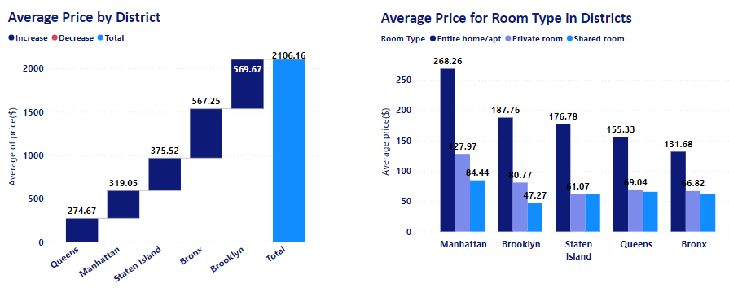
Average Price by District Average Price for Room Type in District
INSIGHTS
As a general Brooklyn is the expensive neighbourhood followed by Bronx
Queens is the cheapest followed by Manhattan
INSIGHTS
With respect to room types Manhattan is the most expensive neighbourhood group followed Brooklyn
The average price of Entire home/apt is highest with dollars 268.25, followed by private room with dollars 127.97 and shared room with dollars 84.44. These average prices are with respect to Manhattan district.
Bronx is the cheapest followed by Queens

Slide 21
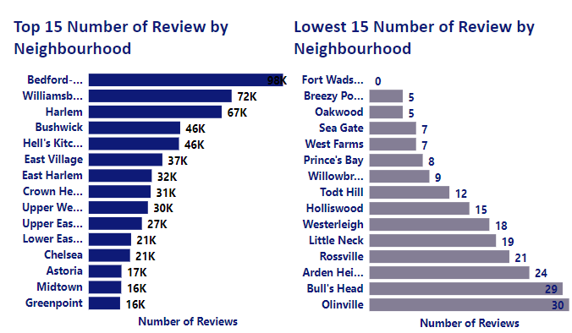
Top and Lowest 15 Number of Reviews by Neighbourhood
INSIGHTS
The number of reviews at each state also shows us that some states have on average significantly more/fewer reviews than others.
we can see that , Bedford-Stuyvesant have the largest amount of reviews followed by Williamsburg in comparison to Fort Wadsworth which having no reviews and Bull's Head, which tend to have fewer reviews.

Slide 22
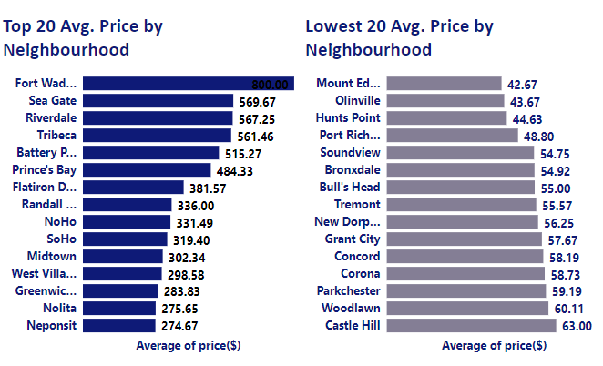
Top and Lowest 20 Average Price by Neighbourhood
INSIGHTS
Ford Wadsworth neighbourhood has the highest average price with 800 dollar dollowed by Sea Gate, River Dale and Tribeca,all3 having avg. Price range between 561 to 569 dollar
Mount Eden has the lowest average price with 42.67 dollar followed by Olinville with 43.67 dollar and then Hunts Point with 44.63 dollar

Slide 23
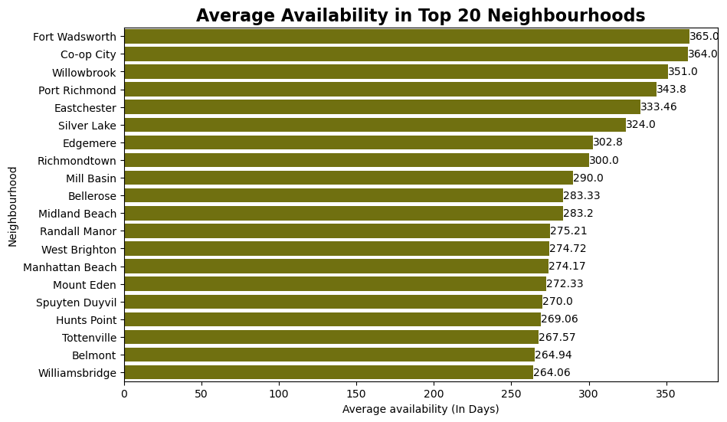
Average Availability in Top 20 Neighbourhood
INSIGHTS
When we look at the availability feature, which tells us how many days a year each listing is available,
We can see that Airbnb in the neighbourhood Fort Wadsworth is available throughout the year i.e,365 days.

Slide 24
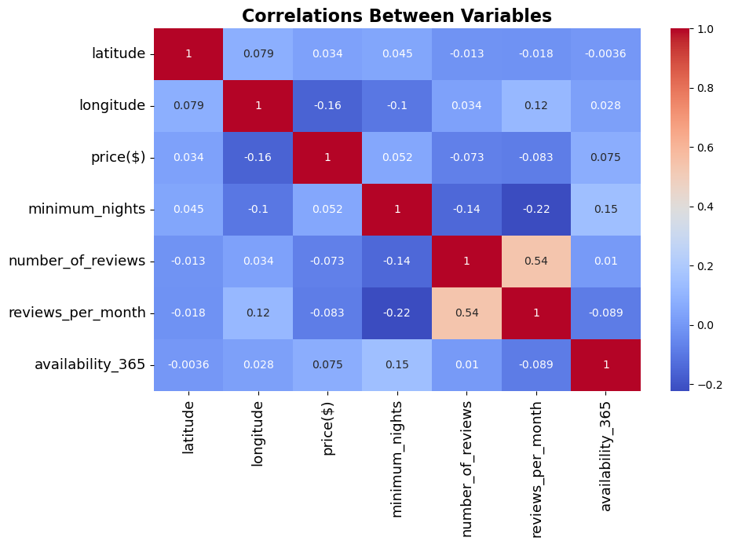
Multivariate Analysis
Correlation Between Numerical Variables
INSIGHTS
Minimum night, Number of reviews, Reviews per month, Availability all have no any significant relation to the Price

Slide 25

Final Summary and Conclusion

Slide 26
Summary
The majority of listings in NYC are of the entire home/apartment type, followed by private rooms and shared rooms.
Manhattan has the highest share of listings followed by Brooklyn, Queens, Bronx and Staten Island.
Prices vary across different regions, with certain regions having higher average prices compared to others.
Average availability in days varies across neighborhoods, with further analysis we can understand the demand and supply dynamics in various neighborhoods.
The price distributions of the room types point that, in general, shared and private rooms have similar prices (less deviation). On the other hand, entire home/ apartments have more variability (and are more expensive, obviously). We don't have data about the properties, but we can guess that other variables like square ft. or being near a metro station affect the price.
When looking at the Popularity/Price plot, we can see that rooms with more reviews tend to be cheaper (although the Entire apartment class is more noisy than the others). This can be explained as: the more expensive is an apartment, the less people stays there and therefore, the less reviews. This would be interesting to use in a model to predict prices or the popularity of a room.

Slide 27
Summary
There is no strong correlation between price of listings and number of reviews.
The most interesting variables regarding price prediction are:
Location
Neighbourhood
Room type
Further analysis is required to analyze the outliers in both price and number of reviews columns.

Slide 28

Thank you

